Slide 1
Sleeping-ta semaphore, mutex, & pointer
Prepared By: Donald, Juliana, & justin

Slide 2
Simulation https://github.com/j-Harder81/CSC385-GroupProject-SleepingTA · GitHub
SLEEPING -TA

Slide 3
Sleeping-TA
“sleeping TA with waiting chairs” simulation.
With user inputted number of students and one TA, it will simulate critical section access represented by three waiting chairs for TA, using Portable Operating System Interface (POSIX) threads, a mutex, and semaphores.

Slide 4
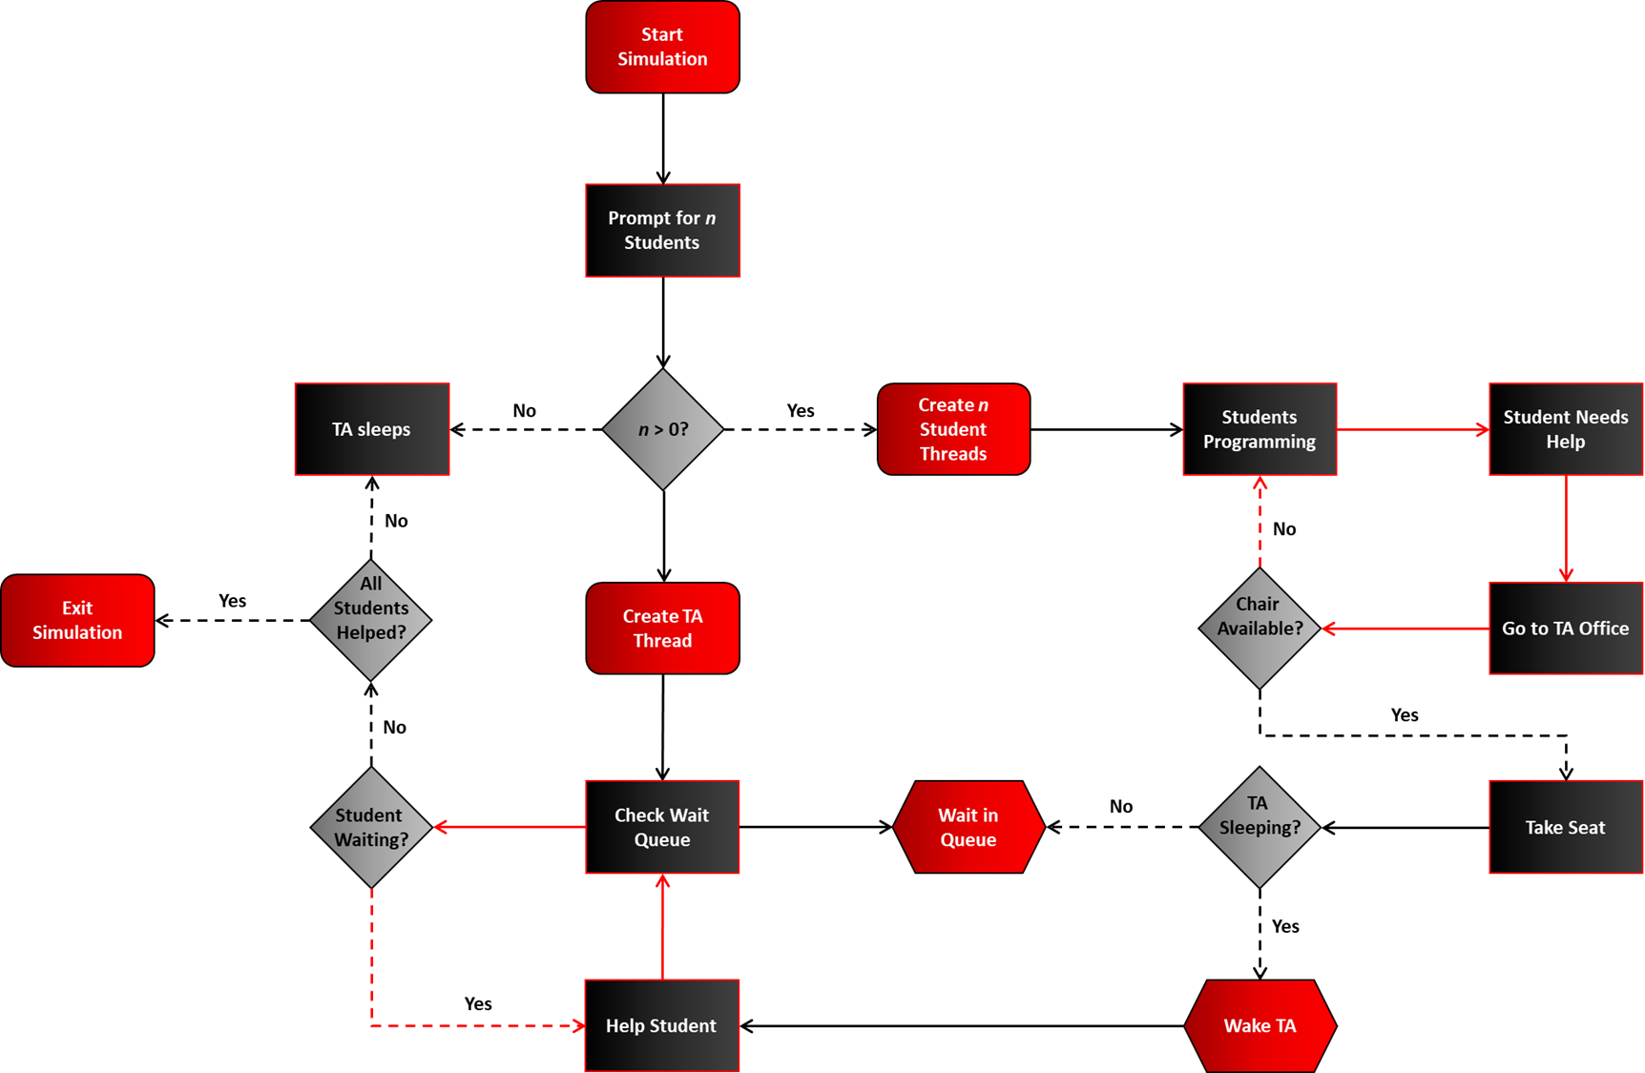

Slide 5
Constants
Semaphore/mutex
Shared state
#define num_seat 3
// number of hallway chairs available
#define sleep_max 5
// max sleep time for ta and students (in seconds)
#ifndef one_and_done
#define one_and_done 1
#endif
// toggle: 1 = student leaves after one help; 0 = student keeps re-queuing
sem_t sem_stu;
// semaphore to wake the ta when students arrive
sem_t *stu_done = null;
// array of semaphores for each student to wait for help completion
pthread_mutex_t mutex;
// mutex to protect shared state (chair queue, counters)
int chair[num_seat] = {0};
// circular queue representing hallway chairs (holds student ids)
int count = 0;
// number of students currently waiting
int next_seat = 0;
// index for next student to sit
int next_teach = 0;
// index for ta to serve next student

Slide 6
Simulation control
Function prototypes
int g_student_num = 0;
// Total number of students
atomic_int running = 1;
// Flag to control simulation loop
atomic_int *helped = NULL;
// Array to track which students have been helped
void rand_sleep(void);
// Simulate a random delay to mimic real-world unpredictability
void* stu_programming(void* stu_id_ptr);
// Entry point for each student thread
void* ta_teaching(void* unused);
// Entry point for TA thread

Slide 7
Main function
Prompt user for number of students
Allocate memory and initialize synchronization
Create ta and student threads
Monitor help completion for all students
Signal shutdown and join threads
Print help summary and clean up resources

Slide 8
int main(void) {
pthread_t *students = NULL; // Array to handle student threads
pthread_t ta; // TA thread handler
int *student_ids = NULL; // Array to store student IDs
// Prompt user for number of students
printf("Please enter the number of students being helped.\n\n");
// Read the input and store it in g_student_num
if (scanf("%d", &g_student_num) != 1 || g_student_num < 0) {
// If input is not a valid integer or is negative, print an error
fprintf(stderr, "Invalid number.\n\n");
return 1; // Exit the program to prevent invalid state
}
// If the number of students is zero, TA stays asleep, and exit the program gracefully
if (g_student_num == 0) {
printf("TA is sleeping. There are no students to help.\n\n");
return 0;
}
// Allocate memory for threads, IDs, semaphores, and help tracking
students = malloc(sizeof(pthread_t) * g_student_num);
student_ids = malloc(sizeof(int) * g_student_num);
stu_done = malloc(sizeof(sem_t) * g_student_num);
helped = calloc(g_student_num, sizeof(atomic_int));
// Check if allocation failed, print error message, and exit program with failure
if (!students || !student_ids || !stu_done || !helped) {
perror("malloc/calloc");
return 1;
}
// Zero out student_ids array to ensure clean initialization
memset(student_ids, 0, sizeof(int) * g_student_num);

Slide 9
// Initialize the semaphore used to wake the TA when a student needs help
if (sem_init(&sem_stu, 0, 0) != 0) { perror("sem_init sem_stu"); return 1; } // Print error if initialization fails and exit with failure
// Initialize a semaphore for each student to signal their turn with the TA
for (int i = 0; i < g_student_num; i++) {
if (sem_init(&stu_done[i], 0, 0) != 0) { perror("sem_init stu_done[i]"); return 1; }
}
// Initialize the mutex used to protect shared resources
if (pthread_mutex_init(&mutex, NULL) != 0) { perror("pthread_mutex_init"); return 1; }
// Seed random number generator for random sleep behavior
srand((unsigned)time(NULL));
// Create TA thread
if (pthread_create(&ta, NULL, ta_teaching, NULL) != 0) {
perror("pthread_create TA"); // Print error if creation fails
return 1; // Exit with failure
}
// Create student threads
for (int i = 0; i < g_student_num; i++) {
student_ids[i] = i + 1; // Assign each student a unique ID
// Create a thread for each student, passing their ID as an argument
if (pthread_create(&students[i], NULL, stu_programming, &student_ids[i]) != 0) {
perror("pthread_create student"); // Print error if creation fails
atomic_store(&running, 0); // Signal shutdown if any thread fails to launch
break; // Stop creating further threads
}
}

Slide 10
// Flag to track whether all students have been helped
int all_helped = 0;
// Loop until all students have been helped
while (!all_helped) {
all_helped = 1; // Assume all helped, then verify
// Check each student’s help status
for (int i = 0; i < g_student_num; i++) {
// If any student has not been helped, reset the flag and break
if (atomic_load(&helped[i]) == 0) {
all_helped = 0;
break;
}
}
usleep(100000); // Sleep briefly to avoid busy waiting
}
// Signal threads to shut down
atomic_store(&running, 0);
// Wake TA if sleeping
sem_post(&sem_stu);
// Wake any blocked students
for (int i = 0; i < g_student_num; i++) sem_post(&stu_done[i]);
// Wait for all student threads to finish execution
for (int i = 0; i < g_student_num; i++) {
pthread_join(students[i], NULL);
}
// Wait for the TA thread to finish execution
pthread_join(ta, NULL);

Slide 11
// Print a help summary
printf("Help Summary:\n");
// Loop through each student and report whether they were helped
for (int i = 0; i < g_student_num; i++) {
// Use atomic_load to safely read the helped[i] flag
printf("Student %d: %s\n", i+1, atomic_load(&helped[i]) ? "Helped" : "Not Helped"); // Print "Helped" if the flag is 1, otherwise "Not Helped“
}
// Cleanup resources
sem_destroy(&sem_stu); // Destroy the semaphore used to signal the TA
// Destroy each student’s semaphore used for signaling help completion
for (int i = 0; i < g_student_num; i++) sem_destroy(&stu_done[i]);
// Destroy the mutex used to protect shared resources
pthread_mutex_destroy(&mutex);
// Free up allocated memory
free(students);
free(student_ids);
free(stu_done);
free(helped);
// Print final message and exit the program gracefully
printf("Simulation ended.\n");
return 0;
}

Slide 12
Student thread function
identify the student
Loop while the simulation is running
Try to sit in a waiting chair for TA
Wake the TA, then wait to be helped
Leave after done

Slide 13
void* stu_programming(void* stu_id_ptr) {
// function requires the thread function to take a void* argument(pointer to any data type)
int id = *(int*)stu_id_ptr;
//assigning int id with integer value stored at where the passed pointer dictates
int my_index = id - 1;
//assigning int my_index with 0-based C array value
printf("\t Student %d is on the way to TA office\n\n", id);
//informing a particular student is on the way

Slide 14
while (atomic_load(&running)) {
// main loop: reads data (occupying waiting area seat) atomically while the global ‘running’ flag is true to prevent data race
rand_sleep();
// Simulate programming time randomly between 1-5 seconds
pthread_mutex_lock(&mutex);
// entering critical section(waiting chair, count, & next_seat) to inspect/update

Slide 15
if (count < NUM_SEAT) {
//if there is at least one waiting chair available
chair[next_seat] = id;
//place current student in next_seat slot
count++;
//update number of student waiting in chairs
printf("\t Student %d is waiting seated at hallway\n\n", id);
printf("\t Student(s) waiting in the chairs : [1] %d [2] %d [3] %d\n\n",
chair[0], chair[1], chair[2]);

Slide 16
next_seat = (next_seat + 1) % NUM_SEAT;
//update the next seat available with circular index, wrapping with modulo
pthread_mutex_unlock(&mutex);
//leaving critical section with consistent critical section data
sem_post(&sem_stu);
// Notify/Wake TA
if (!atomic_load(&running))
break;
//for a safety measure, if for any reason it is not running, exit the loop
Notes:
* the mutex ensures only one thread edits chair[]/count/next_seat at a time.
* next_seat = (next_seat + 1) % NUM_SEAT makes the chairs a circular queue.
* sem_post(&sem_stu) is how students wake the TA; sem_wait(&stu_done[i]) is how a specific student waits for their session to finish.
* ONE_AND_DONE is a compile-time switch: “help me once and I’m done” vs “I’ll come back for more help.”

Slide 17
sem_wait(&stu_done[my_index]);
// Block until TA signals this specific student "you're done".
#if ONE_AND_DONE
break;
// If compiled as one-and-done, exit after a single help session.
#else
continue;
// Otherwise, go back to programming and maybe ask for help again.
#endif
}
Notes:
# *** is C preprocessor directives. They run at compile time

Slide 18
else {
// no chairs available
pthread_mutex_unlock(&mutex);
// Leave critical section without changing anything.
printf("\t Student %d arrived but all waiting chairs are full. Resuming programming and will return later.\n\n", id);
// Log that they’re leaving to try again later.
}
}
return NULL;
// Thread function returns (exits).
}
Notes:
* the mutex ensures only one thread edits chair[]/count/next_seat at a time.
* next_seat = (next_seat + 1) % NUM_SEAT makes the chairs a circular queue.
* sem_post(&sem_stu) is how students wake the TA; sem_wait(&stu_done[i]) is how a specific student waits for their session to finish.
* ONE_AND_DONE is a compile-time switch: “help me once and I’m done” vs “I’ll come back for more help.”

Slide 19
TA Thread function
Wait for a student signal (sleep until a student arrives)
Lock the shared data to safely check chairs
If no students are waiting, keep sleeping or end if all are helped
Take the next student from the waiting chairs
Unlock mutex so others can sit while TA is helping
Help the student for a random time
Mark that student as helped and signal them to leave
Continue until no students remain

Slide 20
TA Thread Start
void* ta_teaching(void* unused) {
(void)unused; // Silence unused parameter warning
Main Loop & Waiting for Students
// TA keeps looping while program is running or there are still students waiting
while (atomic_load(&running) || count > 0) {
// TA sleeps until a student arrives and signals sem_stu
sem_wait(&sem_stu);
// Lock shared data before checking or modifying the chair queue
pthread_mutex_lock(&mutex);

Slide 21
No Students Waiting Case
// If no students are waiting
if (count == 0) {
// If the program is ending and no one is left, TA can rest for good
if (!atomic_load(&running)) {
printf("\t All students have been helped. TA is going back to sleep.\n\n");
}
// Unlock and go back to waiting
pthread_mutex_unlock(&mutex);
continue;
}

Slide 22
Helping the Next Student
// Take the next student in line
int sid = chair[next_teach];
printf("\t\t TA is helping Student %d\n\n", sid);
// Remove the student from the chair and update the queue
chair[next_teach] = 0;
count--;
// Show remaining chairs
printf("\t Student(s) waiting in the chair : [1] %d [2] %d [3] %d\n\n",
chair[0], chair[1], chair[2]);
// Move to the next chair position
next_teach = (next_teach + 1) % NUM_SEAT;
// Unlock so students can sit while TA is helping
pthread_mutex_unlock(&mutex);

Slide 23
Teaching & Signaling Student
// Simulate helping time
rand_sleep();
// TA finished helping this student
printf("\t\t Session finished with Student %d.\n\n", sid);
// Mark student as helped and signal that specific student to leave
int idx = sid - 1;
if (idx >= 0 && idx < g_student_num) {
atomic_store(&helped[idx], 1);
sem_post(&stu_done[idx]); // Tell that student they are done
}
End of TA Thread
// When no students left, TA thread ends
return NULL;

Slide 24
Conclusion
“sleeping TA with waiting chairs” simulation, using Portable Operating System Interface (POSIX) threads, a mutex, and semaphores.
The program demonstrates how semaphores and mutexes can coordinate multiple threads sharing limited resources (Critical Section Data) safely
The key lesson is that proper synchronization and resource management are essential for correct, deadlock-free concurrent programs.

